Slide 1

presentation of technolog information, and communication
By sara laribi
Group 87
Id 31387920

Slide 2
Table of contents
• TIC and related technology : revolutionizing the modern world
• The definition and importance of TIC
• google services: overview and benefit
• microsoft tools: overview and benefits
• git and gitHub: explanation and use cases
• conclusion and future developments

Slide 3


TIC and Related Technologies: Revolutionizing the Modern World
Technology has revolutionized the way we communicate, work, and live. In this presentation, we will explore the impact of information and communication technologies (TIC) and related technologies such as Google services, Microsoft tools, Git, and GitHub.
by sara Laribi
sL

Slide 4

The Definition and Importance of TIC
1
What is TIC?
2
Importance of TIC
TIC stands for Information and Communication Technologies, which are technologies that enable fast and efficient communication and the processing and distribution of information.
TIC has become an essential part of our daily lives, revolutionizing the way we connect, learn, and work. Its impact can be seen in various fields such as education, business, and healthcare.

Slide 5
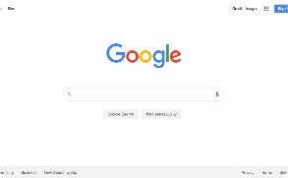
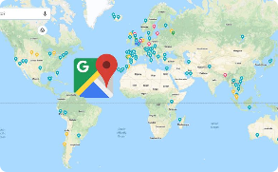


Google Services: Overview and Benefits
Google Search
Google Maps
Google Drive
Gmail
Maps, satellite views, and real-time traffic updates for navigation.
Cloud storage service that lets you store, share, and collaborate on documents, spreadsheets, and presentations.
Email service with powerful spam filters and organizational features.
Search engine that helps you easily find information and websites on the internet.

Slide 6

Microsoft Tools: Overview and Benefits
1
Office Suite
Comprehensive productivity software, including Word, Excel and PowerPoint that make creating and sharing documents easier.
2
Windows OS
Operating system that powers majority of desktops and laptops worldwide.
3
Azure
Cloud computing platform that includes services such as computing, storage, and analytics, offering solutions at scale for businesses.

Slide 7

Git and GitHub: Explanation and Use Cases
Git
GitHub
Git is a version control system that tracks changes to code and helps manage collaborations between developers. It manages the source code history and avoids any conflicts.
Github is a web-based platform used for collaborative software development. It provides hosting for Git repositories, as well as tools for managing projects and code reviews.

Slide 8

Conclusion and Future Developments
In conclusion, TIC and related technologies such as Google services, Microsoft tools, Git, and GitHub play an essential role in today's fast-paced world. They have revolutionized the way we live, work and communicate, and have made our lives easier and more efficient. Looking into the future, developments can be expected in the fields of Artificial intelligence, Robotics, and Blockchain.

